Slide 1
Data Science Engineering Methods and Tools Lecture 9
Northeastern University
College of Engineering
INFO 6105 – Spring 2024
Abdolreza Mosaddegh

Slide 2
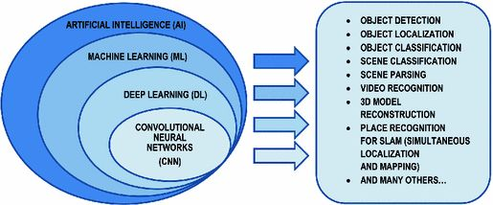
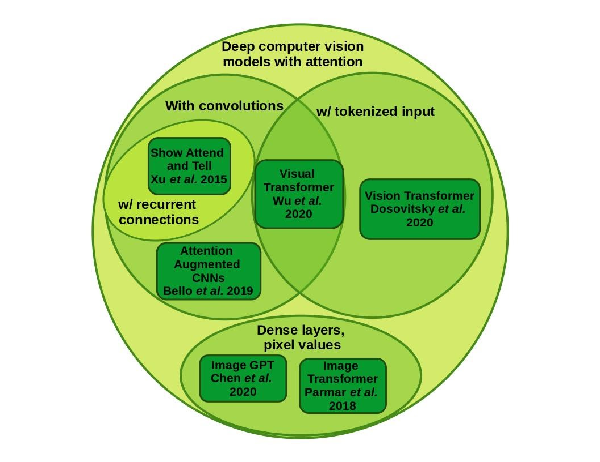
Neural Network Basis for Deep Learning

Slide 3
Artificial Neural Network
Neural Networks loosely mimic the way our brains solve the problem
by taking in inputs, processing them and generating an output.
Like human brain, Neural Network(NN) learn to recognize patterns
Biological Network
Artificial Network
Information is conveyed by mean firing rate of neuron (activations as a series of brief electrical pulses )

Slide 4
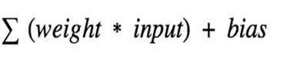
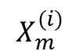
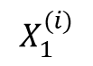
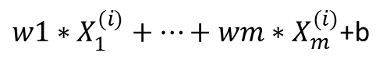
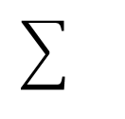
A Single Artificial Neuron
Inputs Weights Bias Activation Function Outputs
b
$$X_{1}^{(i)}$$
w1
${w1∗X}_{1}^{(i)}+…+wm∗X_{m}^{(i)}$+b
A
O
$$X_{m}^{(i)}$$
wm
An artificial neuron creates output using two components:
(1) weighted sum of inputs plus a bias
(2) activation function.
Weights and bias represent a linear function on inputs
Using Activation function it decides whether it should be activated (fired) or not (e.g., output of 1 as activated and 0 as not activated).

Slide 5
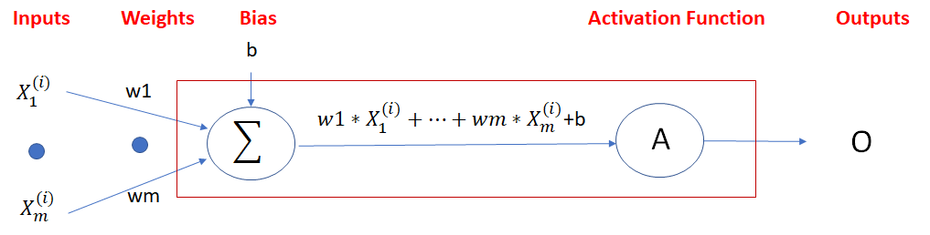
Activation Function
The sum of weighted plus bias can be any value ranging from -inf to +inf.
We use activation functions to convert this range to a limited range (e.g., -1 to 1), make it easier to decide on activation.
Without activation function, the output would be a polynomial linear function with less power to learn complex patterns comparing non-leaner functions.
Non-Linear Activation functions can learn non-linear complex functional mappings between the inputs and response.

Slide 6
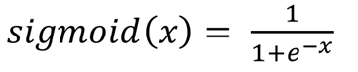
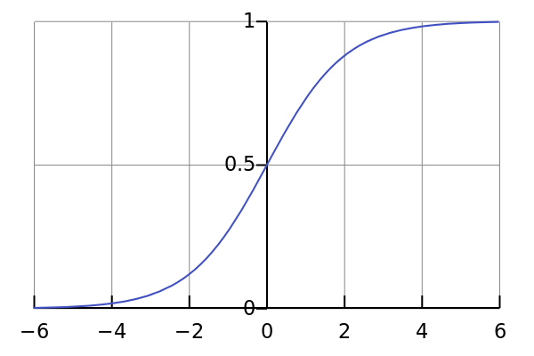
Activation Functions - Sigmoid
It is nonlinear in nature. Combinations of this function are also nonlinear
the output of the activation function is always going to be in range (0,1)
Sigmoid functions can be used in binary classification (> 0.5 is 1 else 0)

Slide 7
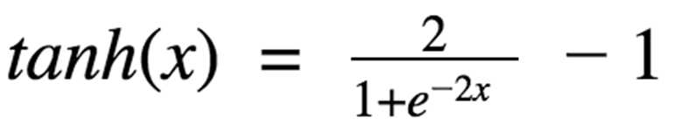
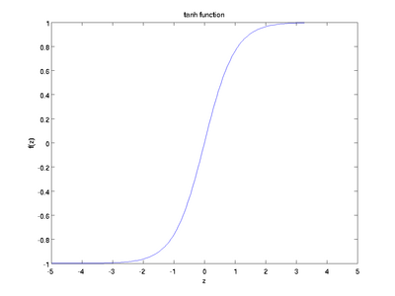
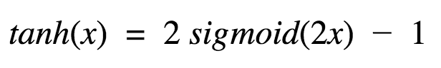
Activation Functions - Tanh
The output of the activation function is always going to be in range (-1,1)
Tanh is also a widely used non-linear activation function, especially in time series data
This looks very similar to sigmoid. In fact, it is a scaled sigmoid function

Slide 8
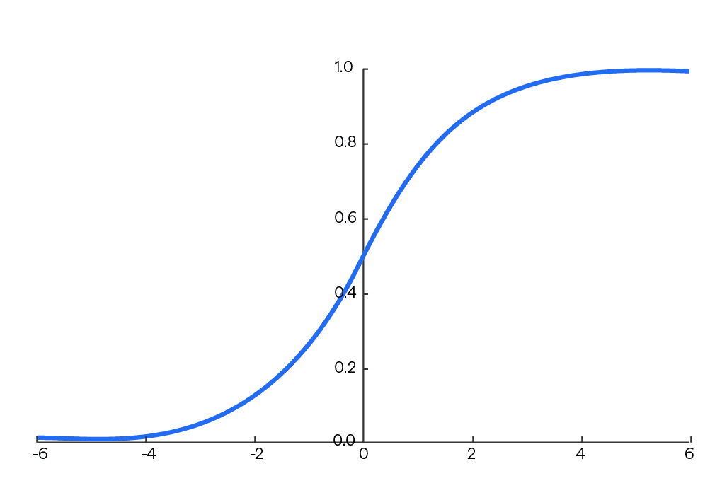
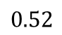
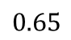
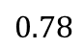
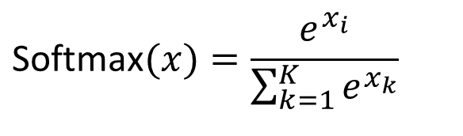
Activation Functions - Softmax
The output of the activation function is always going to be in range (0,1)
Divides by the sum of all outputs, allows for probability distribution.
Useful for multi-class classification problems.
$$\text{Softmax}(x)=\frac{e^{x_{i}}}{\sum_{k=1}^{K}{e^{x_{k}}}}$$
Sigmoid
Softmax
$$0.78$$
Class1
Class1
$$0.65$$
Class2
Class2
$$0.52$$
Class3
Class3

Slide 9
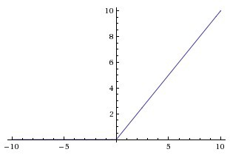
Activation Functions - ReLu
The output of the activation function is always going to be in range (0,inf)
ReLu is non-linear in nature and combinations of ReLu are also non-linear
Using a sigmoid or tanh will cause almost all neurons to activate, but in ReLu almost 50% of the network yields 0 activation because of the characteristic of ReLu. This means the network is lighter.
ReLu is less computationally expensive than tanh and sigmoid because it involves simpler mathematical operations.
ReLu(x) = max(0,x)

Slide 10
Selection of Activation Function
When you know the function you are trying to approximate has certain characteristics, you can choose an activation function which will approximate the function faster leading to faster training process.
Sigmoid can be used for the output layer in binary classification.
Softmax is usually used for the output layer in multi-class classification.
Sigmoid, Tanh and ReLU can be used for hidden layers.
ReLU works most of the time as a general approximator in hidden layers
There are also many other activation functions such as Leaky ReLU, etc. can be used to address different issues in Neural Networks

Slide 11
Training – Problem Statement
Training is to find weights and biases in a way that produce best outputs.
The goal is to minimize the error / cost between the predicted and real (target) outputs and we need a metric to quantify this error (loss).
Loss function compares the real outputs (target) and predicted output values.
Regression Loss Functions: used in regression neural networks; given an input, the model predicts a corresponding continuous value (rather than classes). Example: Sum Squared Error, Mean Squared Error
Classification Loss Functions: used in classification neural networks; given an input, the neural network produces probabilities of belonging to various classes (categories). The class with the highest probability of belonging can be selected as the predicted class.
Examples: Binary Cross-Entropy (Binary Classification),
Categorical Cross-Entropy (Multi-class Classification)

Slide 12

Loss Function
There are many measures to quantify this error and one of the most popular measure is Sum of Squared Errors. For a single output SSE can be defined as:
In SSE positive and negative differences between predicted output and real output don’t cancel each other
$$E= (Real Label−Output of Neural Network)^{2}$$
To facilitate derivative operations, we can also use:
$E= \frac{1}{2}(Real Label−Output of Neural Network)^{2}$ $= \frac{1}{2}(Y−O)^{2}$

Slide 13
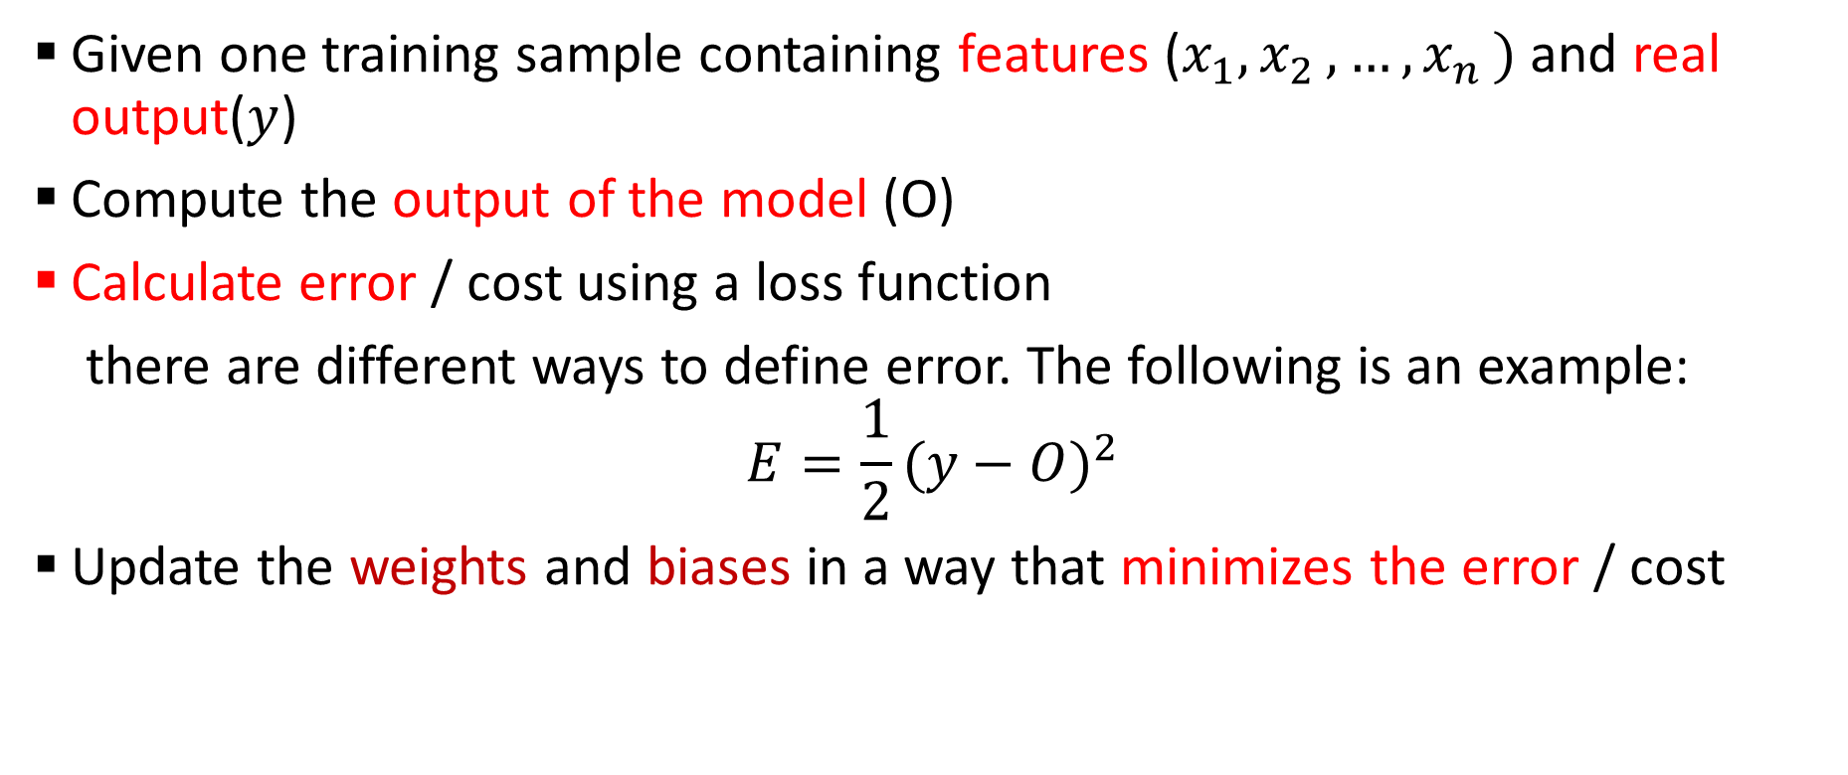
Training of a Single Neuron
Given one training sample containing features ($x_{1}{,x}_{2}, …{,x}_{n})$ and real output($y$)
Compute the output of the model (O)
Calculate error / cost using a loss function
there are different ways to define error. The following is an example:
$$E=\frac{1}{2}(y−O)^{2}$$
Update the weights and biases in a way that minimizes the error / cost

Slide 14
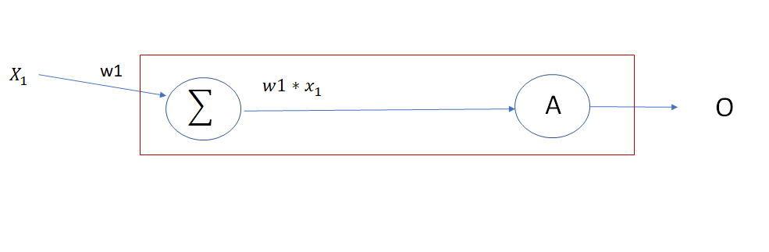
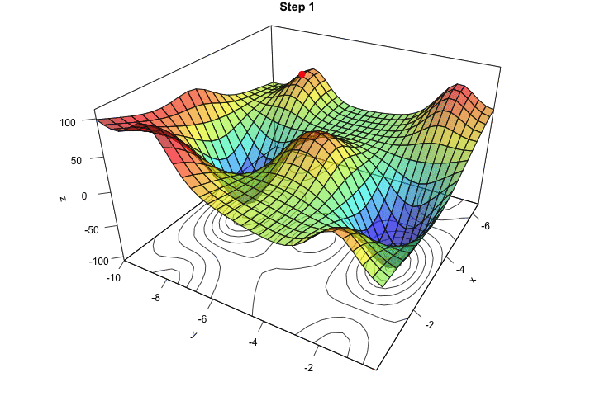
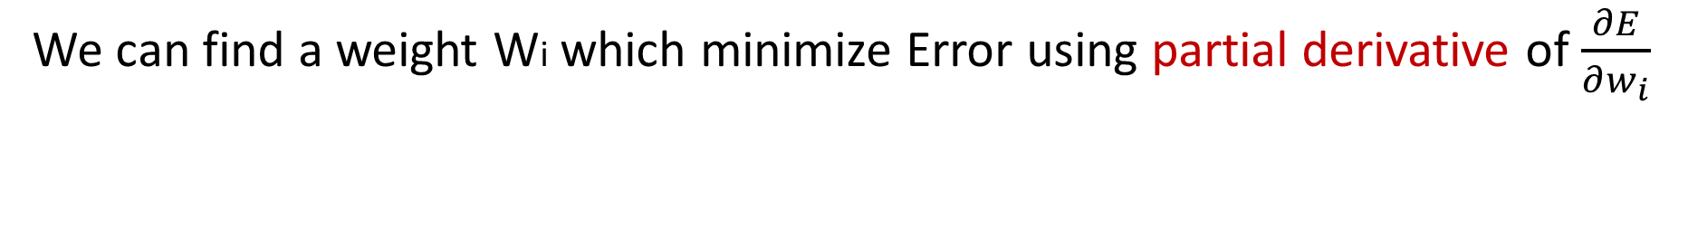
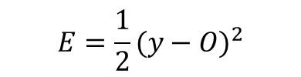

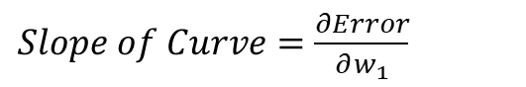
Minimizing Error
We can find a weight Wi which minimize Error using partial derivative of $\frac{∂E}{∂w_{i}}$
$$E=\frac{1}{2}(y−O)^{2}$$
Error
$Slope of Curve=\frac{∂Error}{∂w_{1}}$
$Slope of Curve=\frac{∂Error}{∂w_{1}}$ = 0
Usually we need to minimize error against more than one para𝑚𝑒𝑡𝑒𝑟
W1

Slide 15
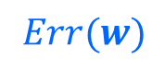

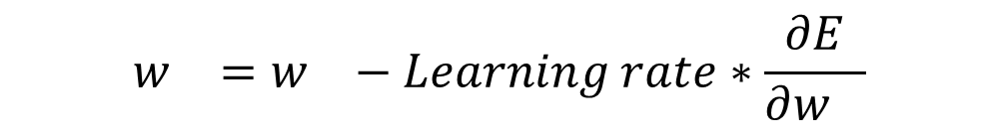
Gradient Descent
Gradient descent is a greedy iterative optimization algorithm that is used to approximate the optimized weights which minimize the loss function.
The goal is then to minimize the error by iteratively moving downwards using a step size (Learning Rate).
$$w_{}=w_{}−Learning rate∗\frac{∂E}{∂w_{}}$$

Slide 16
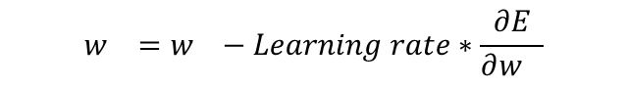

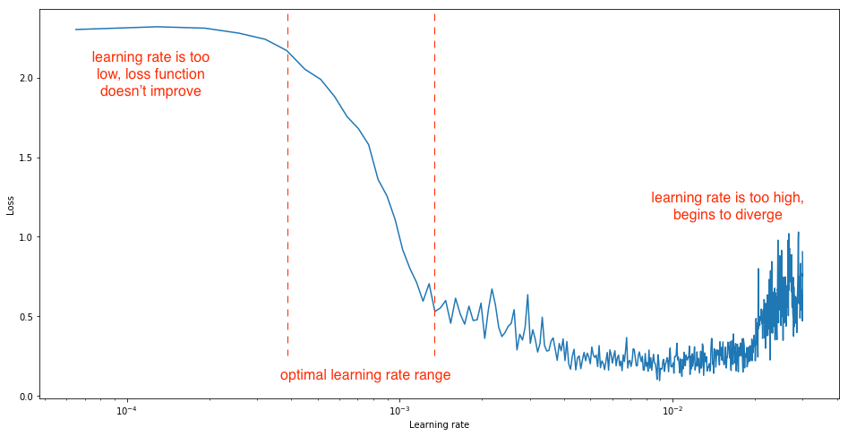
Learning Rate
Learning rate is a hyperparameter that determines how big a step is taken.
A too high learning rate will make the learning jump over minima
A too low learning rate will either take too long to converge or get stuck in a local minimum
Usually, optimal learning rate should be somewhere between 0.001 and 0.01 depends on optimization method

Slide 17
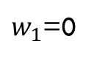
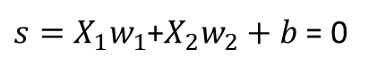
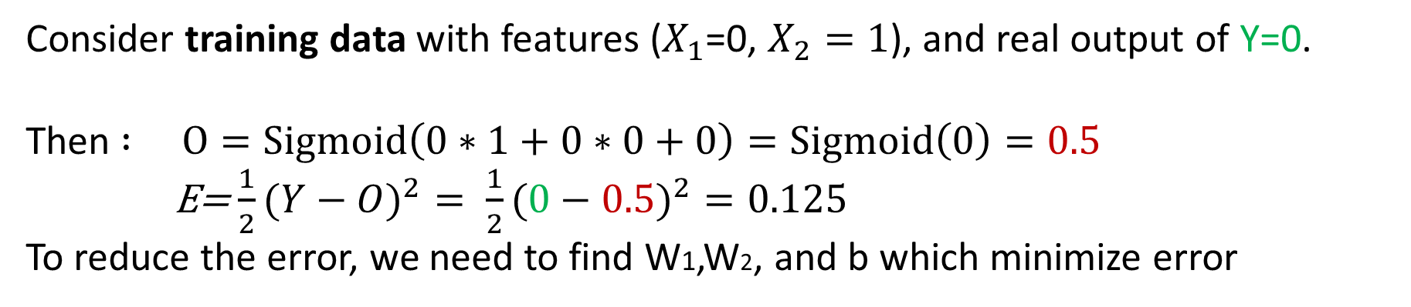
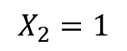
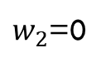
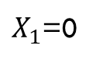
Training of a Single Neuron - Example
b=0
$X_{1}$=0
$w_{1}$=0
$s=X_{1}w_{1}$+$X_{2}w_{2}+b$ = 0
∑
Sigmoid
O=Sigmoid(0)=0.5
Activation function
$$X_{2}=1$$
$w_{2}$=0
Consider training data with features ($X_{1}$=0, $X_{2}=1$), and real output of Y=0.
Then $: O=Sigmoid\left(0∗1+0∗0+0\right)=Sigmoid\left(0\right)=0.5$
E=$\frac{1}{2}(Y−O)^{2}= \frac{1}{2}(0−0.5)^{2}=0.125$
To reduce the error, we need to find W1,W2, and b which minimize error

Slide 18
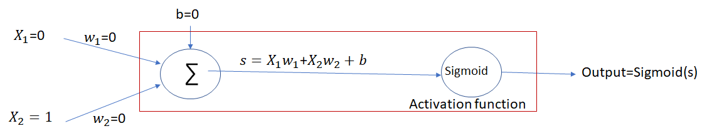
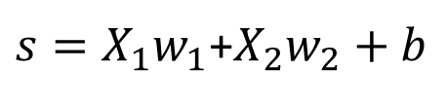
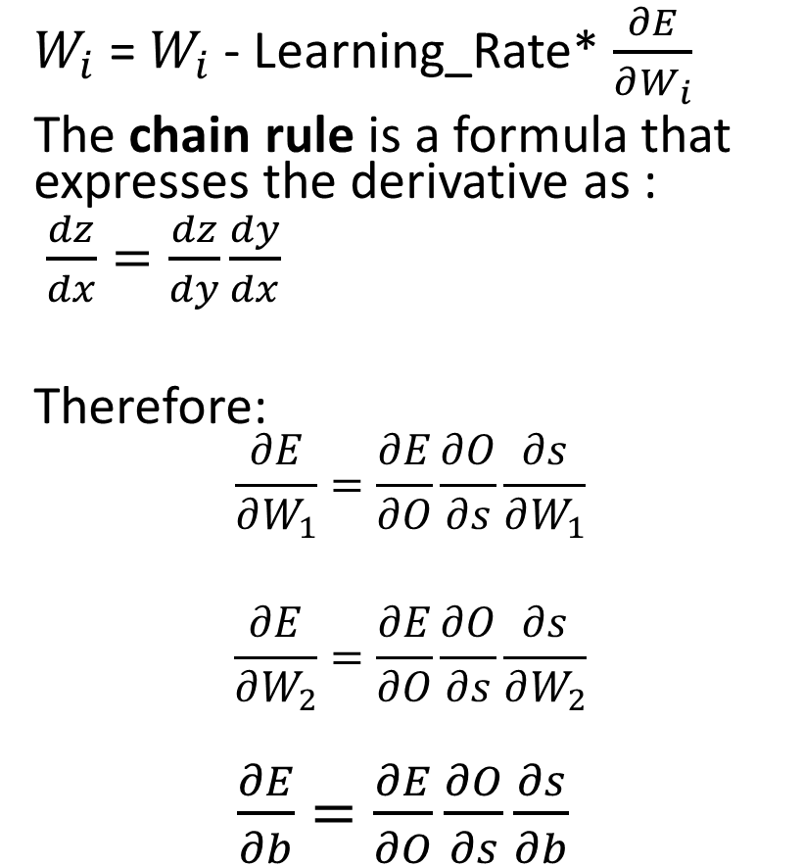
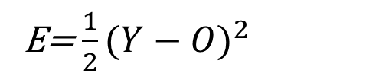
Update Weights
$W_{i}$ = $W_{i}$ - Learning_Rate* $\frac{∂E}{∂W_{i}}$
The chain rule is a formula that expresses the derivative as :
$\frac{dz}{dx}=\frac{dz}{dy}\frac{dy}{dx}$
Therefore:
$$\frac{∂E}{∂W_{1}}=\frac{∂E}{∂O}\frac{∂O}{∂s}\frac{∂s}{∂W_{1}}$$
$$\frac{∂E}{∂W_{2}}=\frac{∂E}{∂O}\frac{∂O}{∂s}\frac{∂s}{∂W_{2}}$$
$\frac{∂E}{∂b}=\frac{∂E}{∂O}\frac{∂O}{∂s}\frac{∂s}{∂b}$
$s=X_{1}w_{1}$+$X_{2}w_{2}+b$
O = Sigmoid(s)
E=$\frac{1}{2}(Y−O)^{2}$

Slide 19
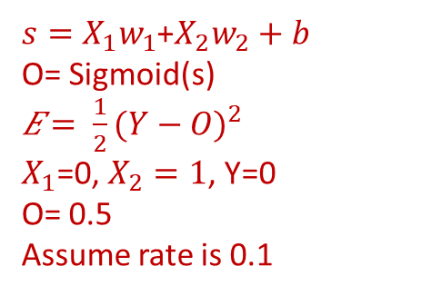
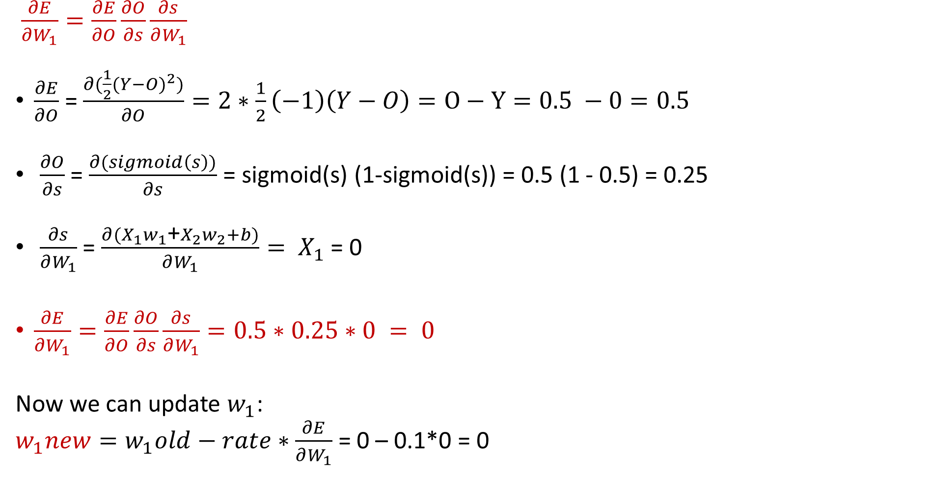
Training of a Single Neuron - Example
$\frac{∂E}{∂W_{1}}=\frac{∂E}{∂O}\frac{∂O}{∂s}\frac{∂s}{∂W_{1}}$
$\frac{∂E}{∂O}$ = $\frac{∂(\frac{1}{2}(Y−O)^{2})}{∂O}=2∗\frac{1}{2}\left(−1\right)\left(Y−O\right)=O−Y=0.5 −0=0.5$
$\frac{∂O}{∂s}$ = $\frac{∂(sigmoid\left(s\right))}{∂s}$ = sigmoid(s) (1-sigmoid(s)) = 0.5 (1 - 0.5) = 0.25
$\frac{∂s}{∂W_{1}}$ = $\frac{∂{(X}_{1}w_{1}\text{+}X_{2}w_{2}+b)}{∂W_{1}}= X_{1}$ = 0
$\frac{∂E}{∂W_{1}}=\frac{∂E}{∂O}\frac{∂O}{∂s}\frac{∂s}{∂W_{1}}=0.5∗0.25∗0 = 0$
Now we can update $w_{1}$:
$w_{1}new=w_{1}old−rate∗\frac{∂E}{∂W_{1}}$ = 0 – 0.1*0 = 0
$s=X_{1}w_{1}$+$X_{2}w_{2}+b$
O= Sigmoid(s)
𝐸 $= \frac{1}{2}(Y−O)^{2}$
$X_{1}$=0, $X_{2}=1$, Y=0
O= 0.5
Assume rate is 0.1

Slide 20
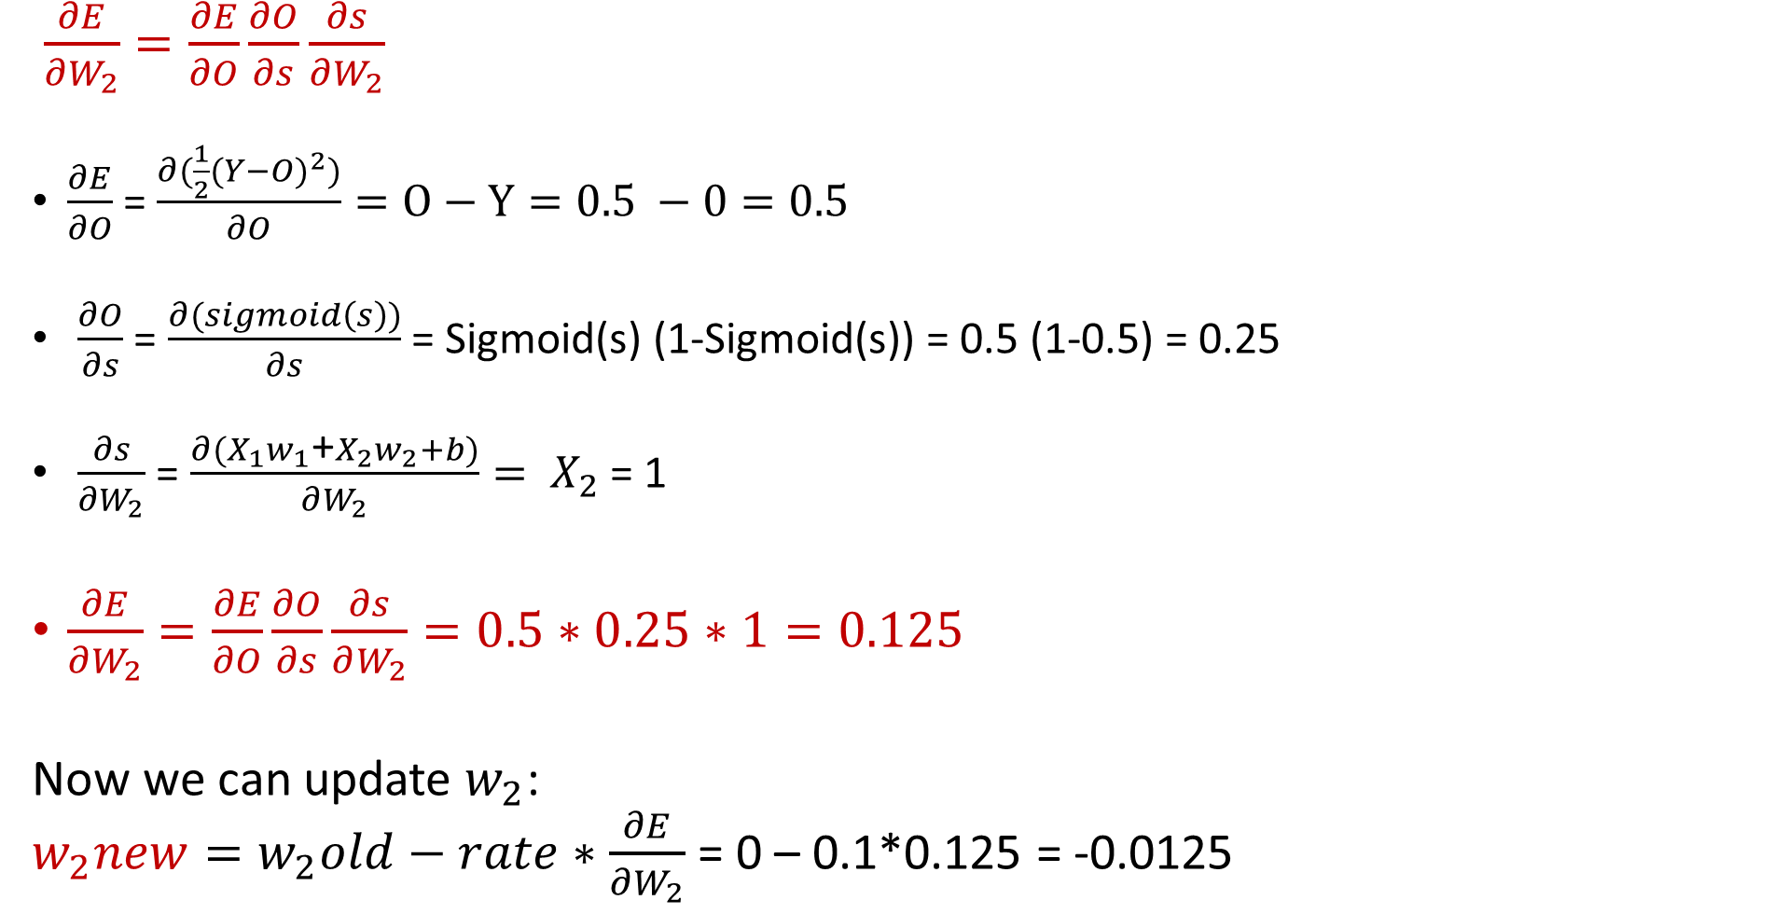
Training of a Single Neuron - Example
$\frac{∂E}{∂W_{2}}=\frac{∂E}{∂O}\frac{∂O}{∂s}\frac{∂s}{∂W_{2}}$
$\frac{∂E}{∂O}$ = $\frac{∂(\frac{1}{2}(Y−O)^{2})}{∂O}=O−Y=0.5 −0=0.5$
$\frac{∂O}{∂s}$ = $\frac{∂(sigmoid\left(s\right))}{∂s}$ = Sigmoid(s) (1-Sigmoid(s)) = 0.5 (1-0.5) = 0.25
$\frac{∂s}{∂W_{2}}$ = $\frac{∂{(X}_{1}w_{1}\text{+}X_{2}w_{2}+b)}{∂W_{2}}= X_{2}$ = 1
$\frac{∂E}{∂W_{2}}=\frac{∂E}{∂O}\frac{∂O}{∂s}\frac{∂s}{∂W_{2}}=0.5∗0.25∗1=0.125$
Now we can update $w_{2}$:
$w_{2}new=w_{2}old−rate∗\frac{∂E}{∂W_{2}}$ = 0 – 0.1*0.125 = -0.0125
$s=X_{1}w_{1}$+$X_{2}w_{2}+b$
O= Sigmoid(s)
𝐸 $= \frac{1}{2}(Y−O)^{2}$
$X_{1}$=0, $X_{2}=1$, Y=0
O= 0.5
Assume rate is 0.1

Slide 21
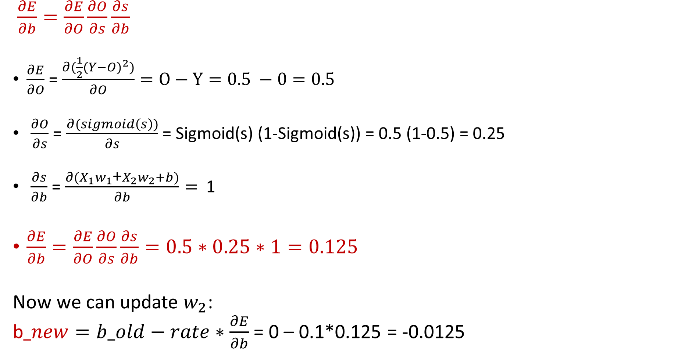
Training of a Single Neuron - Example
$\frac{∂E}{∂b}=\frac{∂E}{∂O}\frac{∂O}{∂s}\frac{∂s}{∂b}$
$\frac{∂E}{∂O}$ = $\frac{∂(\frac{1}{2}(Y−O)^{2})}{∂O}=O−Y=0.5 −0=0.5$
$\frac{∂O}{∂s}$ = $\frac{∂(sigmoid\left(s\right))}{∂s}$ = Sigmoid(s) (1-Sigmoid(s)) = 0.5 (1-0.5) = 0.25
$\frac{∂s}{∂b}$ = $\frac{∂{(X}_{1}w_{1}\text{+}X_{2}w_{2}+b)}{∂b}=$ 1
$\frac{∂E}{∂b}=\frac{∂E}{∂O}\frac{∂O}{∂s}\frac{∂s}{∂b}=0.5∗0.25∗1=0.125$
Now we can update $w_{2}$:
b$_new=b_old−rate∗\frac{∂E}{∂b}$ = 0 – 0.1*0.125 = -0.0125
$s=X_{1}w_{1}$+$X_{2}w_{2}+b$
O= Sigmoid(s)
𝐸 $= \frac{1}{2}(Y−O)^{2}$
$X_{1}$=0, $X_{2}=1$, Y=0
O= 0.5
Assume rate is 0.1

Slide 22
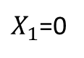
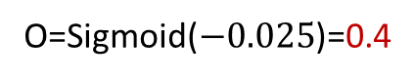
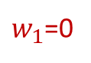
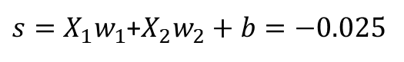
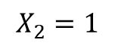
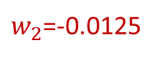
Training of a Single Neuron - Example
b=-0.0125
$X_{1}$=0
$w_{1}$=0
∑
$s=X_{1}w_{1}$+$X_{2}w_{2}+b=−0.025$
Sigmoid
O=Sigmoid($−0.025$)=0.4
$$X_{2}=1$$
$w_{2}$=-0.0125
Activation function
$$w_{1}\text{=0}\text{,}{ w}_{2}\text{=−0.0125}\text{, }\text{b}\text{=−0.0125 }\text{Then}: O=Sigmoid\left(0∗0+1∗−0.0125− 0.0125\right)=Sigmoid\left(−0.025\right)=0.4$$
$$\text{E}\text{=} \frac{1}{2}(Y−O)^{2}= \frac{1}{2}(0−0.4)^{2}=0.08$$
This process is repeated until the error is sufficiently small (below a threshold) or a maximum number of iteration is reached or there is no significant decrease in error.
Gradient descent can get stuck in the local optimal, therefore, sometimes the results are not globally optimal.

Slide 23
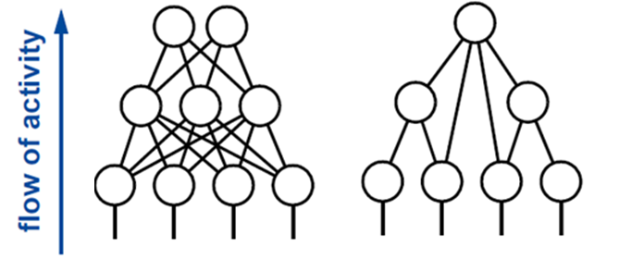
Multi-level Feedforward Neural Networks
A multi-level feedforward neural network is a neural network that consists of multiple levels (layers) of neurons. Each level can have multiple neurons and connections between neurons in different levels do not form loops.
Information moves in one direction (forward) from input nodes, through hidden nodes, to output nodes.
Neural Neurons can learn complex functions.
A neural network with one hidden layer (with infinite number of neurons) can train for any continuous function.

Slide 24

Feedforward Neural Networks
The input layer is fed the raw input and passes this information on to the next layer in the artificial neural network (typically a hidden layer).
The neurons in the hidden layer process the information, then pass the results on to the next layer (another hidden or output layer) of artificial neurons.
The output layer creates results for regression (continuous values) and classification (classes).
Hidden layers allow the network to learn complex non-linear relationships between the inputs and outputs.

Slide 25
Neural Network Model
Input Layer
Hidden Layer
Output Layer
Age
34
.6
.4
“Probability of Diabetes”
.2
Σ
.1
.5
0.6
BMI
29
Σ
.3
.2
.8
.7
Σ
Glucose
140
.2
Inputs
(Features)
Weights
Weights
Outputs

Slide 26

Partially vs Fully Connected Layer
A Fully Connected (FC) layer, also known as a dense layer, is a type of layer used in artificial neural networks where each neuron or node from the previous layer is connected to each neuron of the current layer.
Fully Connected (Dense)
Partially Connected (Sparse)

Slide 27
Parameters of Artificial Neural Network
A neural network consists of layers of artificial neurons and connections between them (parameters).
Each connection is associated with a weight.
Training of a neural network is to get to the right weights (and biases) such that the error across the training data is minimized.
Input
layer
Hidden
layer 1
Hidden
layer 2
Hidden
layer 3
Output
layer
Number of parameters =
3*4 + 4*3 + 3*4 + 4* 2 = 44
If there are biases those also should be added to this number

Slide 28



Matrix Representation of Neural Networks

Slide 29


Training Neural Network
Each training input is loaded into the neural network in a process called forward propagation.
Once the model has produced an output, this predicted output is compared against the given real output (target) in a process called backpropagation, the weights of the model are then adjusted to produce a result closer to the target output.
forward propagation.
Backward propagation

Slide 30

Backward Propagation
The goal of backpropagation is to optimize the weights so that create output close to target outputs.
To optimize the output, we need to adjust corresponding weights also output from the last layer.
To adjust the output from last layer we need to adjust corresponding weights also output from the two last layer, and so on ….
So, the method that was suggested was to take the errors at the output layer and proportionally propagate them backwards to the hidden layer.
Gradient Decent can be used to adjust weights.

Slide 31

Algorithm for Training Neural Network
Initialize the weights $\vec{W}=[W_{0}^{}, W_{1}^{}, ……, W_{k}^{}]$ randomly
Training iterations:
For each training data $(x^{\left(i\right)},y^{(i)}$), Using forward propagation to compute the neural network output vector
Compute the error $E$ (various definitions)
Use backward propagation to compute$\frac{∂E}{∂W_{k}}$for each weight $W_{k}$
Update $W_{k}$=$W_{k}−LearningRate ∗\frac{∂E}{∂W_{k}}$
Repeat until termination criteria are satisfied.

Slide 32

Back Propagation- Example
Given the following initial weights and biases and Sigmoid as activation function for the network and training inputs with features of 0.05 and 0.10 and real outputs of 0.01 and 0.99.

Slide 33
Forward Propagation
h1_in = i1*w1 + i2*w2 + b1
= 0.15 * 0.05 + 0.2*0.1 + 0.35 +1
= 0.3775
h1_out = Sigmoid(0.3775) = 0.5933
And in a same way:
h2-out = 0.5969
o1_in = h1_out*w5 + h2_out *w6 + b2 = 1. 1059
o1_out = Sigmoid(1. 1059 ) = 0.7514
And in a same way:
o2_out = 0.7729

Slide 34

Calculating Error using Loss Function
Error _ o1=$\frac{1}{2}(Target1−O{utput1)}^{2}$ = $\frac{1}{2}(0.01−0.7514)^{2}$ = 0.2748
Error _ o2=$\frac{1}{2}(Target2−O{utput2)}^{2}$ = $\frac{1}{2}(0.99−0.7729)^{2}$ = 0.0236
Error_Total = 0.2748 + 0.0236 = 0.2984

Slide 35


Partial Derivatives
To update W5 first we need to find : $\frac{∂E}{∂W_{5}}$:
Chain Rule: $\frac{∂E}{∂W_{5}}=\frac{∂E}{∂O1_Out} \frac{∂O1_Out}{∂O1_In} \frac{∂O1_In}{∂W_{5}}$
Error_Total = $\frac{1}{2}(Target1−Output{1)}^{2}$ + $\frac{1}{2}(Target2−Output{2)}^{2}$
$\frac{∂E}{∂O1_Out}$ = -1* ($Target1−Output{1)}^{}$= -(0.01-0.7514) = 0.7414
$\frac{∂O1_Out}{∂O1_In}$ = $\frac{∂\text{sigmoid}\text{(}O1_In)}{∂O1_In}$ = $\text{sigmoid}\text{(}O1_In)$ (1- $\text{sigmoid}\text{(}O1_In)$) = 0.7514*(1-0.7514) = 0.1868
$\frac{∂O1_In}{∂W_{5}}$ = $\frac{∂(\text{h}\text{1_}\text{out}\text{∗}\text{w}\text{5 + }\text{h}\text{2_}\text{out}\text{ ∗}\text{w}\text{6 + }\text{b}\text{2})}{∂W_{5}}$ = $\text{h}\text{1_}\text{out}$ = 0.5933
$\frac{∂E}{∂W_{5}}=$ 0.7414* 0.1868* 0.5933 =0.0822

Slide 36

Update Weights – Output Layer
Suppose that learning_rate = 0.5
W5_new = W5_old - learning_rate * $\frac{∂E}{∂W_{5}}$ = 0.4 – 0.5 * 0.0822 = 0.3589
In a same way:
W6_new =0.4086
W7_new =0.5113
W8_new =0.5613
We can use a same method for updating biases (we ignore updating biases in this example)
The new weights are not updated till all new weights are calculated

Slide 37



Partial Derivatives
Now we update the hidden layer:
Chain Rule: $\frac{∂E}{∂W_{1}}=\frac{∂E}{∂h1_Out} \frac{∂h1_Out}{∂h1_In} \frac{∂h1_In}{∂W_{1}}$
$\frac{∂E}{∂h1_Out}$ = $\frac{∂E_o1}{∂h1_Out} +\frac{∂E_o2}{∂h1_Out}$
Chain Rules: $\frac{∂E_o1}{∂h1_Out}= \frac{∂E_o1}{∂o1_In_}$ * $\frac{∂o1_In}{∂h1_Out}$
$\frac{∂E_o1}{∂o1_In}$ = $\frac{∂E_o1}{∂o1_Out}$ * $\frac{∂o1_Out}{∂o1_In}$ = 0.7414 * 0.1868 = 0.1385
$\frac{∂o1_In}{∂h1_Out}$ = $\frac{∂(h1_Out \text{∗} \text{w}\text{5 +}h2_Out \text{∗} \text{w}\text{6 + }\text{b}\text{2})}{∂h1_Out}$ = W5 = 0.40
→ $\frac{∂E_o1}{∂h1_Out}$ = 0.1385 * 0.40 = 0.0554
$\frac{∂E_o1}{∂o1_Out}$ and $\frac{∂o1_Out}{∂o1_In}$ are calculated in the last step
Notes:
Has an impact on both outputs also errors

Slide 38

Update Weights – Hidden Layer
In a same way:
$\frac{∂E_o2}{∂h1_Out}$ = -0.0190 → $\frac{∂E}{∂h1_Out}$ = 0.0554 -0.0190 = 0.0364
$\frac{∂h1_Out}{∂h1_In}$ = $\frac{∂\text{S}\text{igmoid}\text{(}h1_In)}{∂h1_In}$ = $\text{sigmoid}\text{(}h1_In)$ (1- $\text{sigmoid}\text{(}h1_In)$) = 0.5933 * (1- 0.5933) = 0.2413
$\frac{∂h1_In}{∂W_{1}}$ = $\frac{∂\left(\text{i}\text{1∗}\text{w}\text{1 + }\text{i}\text{2∗}\text{w}\text{3 + }\text{b}\text{1}\right) }{∂W_{1}}$ = i1 = 0.05
$\frac{∂E}{∂W_{1}}$ = 0.0364 * 0.2413 * 0.05 = 0.00044
W1_new = W1_old - learning_rate * $\frac{∂E}{∂W_{1}}$ = 0.15 – 0.5 * 0.00044 = 0.1498
In a same way : W2_new = 0.1996 , W3_new =0.2498, W4_new = 0.2995
We can use a same method for updating biases (we ignore updating biases in this example).

Slide 39
Epochs
After calculation of all new weights and biases, all the weights and biases will be updated in the network together.
In a same way of calculation error in the first step:
Error_Total = 0.2910 (it was 0.2984)
We repeat the process for new iterations (epochs) until the error less than a threshold or iterations more than a maximum threshold or decrease in error is not significant (no improvement).

Slide 40

Stochastic Gradient Descent (SGD)
Runs one training example per iteration (epoch) and updates each training example's parameters one at a time.
Less computational resource for each epoch, therefore more practical for large datasets.
Gradient path is noisier and usually it needs more updates since the model trained for a single example in each epoch.
Less prone to local optimum since there are more noises in the path.
it shows some computational efficiency losses in comparison to batch gradient since the path is noisier.

Slide 41

Batch Gradient Descent
All the training data is taken into consideration to take a single step(epoch).
Take the average of errors and the gradients of all the training examples and then use them to update parameters.
It repeats this process several times based on a given hyperparameter (number of epochs).
It produces less noise since average of samples is used.
If the dataset is large, it needs a lot of computation resource for training model in each epoch since it uses all data in each epoch.
Prone to local optimum (Gradient Descent is a greedy algorithm)

Slide 42

Mini Batch Gradient Descent
Mini Batch gradient descent is the combination of both batch gradient descent and stochastic gradient descent.
It divides the training datasets into small batch sizes (e.g., 16, 32, 64, or 128) then performs the updates on those batches separately.
Splitting training datasets into smaller batches make a balance to maintain the computational efficiency of batch gradient descent and speed of stochastic gradient descent.

Slide 43

Optimizer
Optimizers are methods used to change the attributes of neural network such as weights and biases in order to reduce the losses each equipped with distinct gradient descent algorithms, update rules, learning rates, and strategies to converge towards optimal parameter.
Well-known optimizers encompass Stochastic
Gradient Descent (SGD), Adam, and RMSprop.
Selection of optimizer depends on type of neural
network, data , application, etc..
Adam is one of the most popular optimizer

Slide 44


Optimal Number of Layers and Neurons
A Neural Network with a single hidden layer can approximate any function that contains a continuous mapping from one finite space to another.
The number of neurons in the input layer equals the number of input features in the data being processed.
If the NN is a regressor, then the output layer has a single node.
If the NN is a classifier, then if the activation function in output layer is Sigmoid (binary classification) it is a single node and if it is Softmax (multi-class classification) it is equal to the number of classes.

Slide 45
Optimal Number of Neurons in Hidden Layer
The number of neurons required for the hidden layer depends on amount of outliers, the complexity of data, and the type of activation functions used. There are some best practices for number of neurons in the hidden layer:
The number of neurons in a hidden layer should be between the size of the input layer and the size of the output layer.
The number of neurons in a hidden layer should be 2/3 the size of the last layer (input or last hidden layer).
Validation data can be used to find an optimal number of hidden layers and neurons which minimize error.

Slide 46
Data Pre-processing for Neural Networks
Normalizing data is recommended since it facilitates training process. Without normalizing data, convergence may take more iterations and sometimes the algorithm will not converge before the number of maximum iterations allowed. Usually scaling in the interval [0,1] (e.g., MinMax Scaling) tends to give better results.
Removing outliers and noisy data is recommended since some optimization methods are prone to overfitting.
Usually, Data imputation is recommended for handling large number of missing values in training dataset, since it improves performance especially in some optimization methods and some architectures of neural networks.

Slide 47

Model Interpretability
Neural networks are black boxes models.
The results can be produced by combination results of multiple hidden layers containing non-linear functions
Interpretation of such results is not straight forward.
As a general rule, more complex models are more accurate but less explainable and vice versa.

Slide 48

Impactful Decisions
Some application needs more interpretability
In general, the more impactful a system in terms of the decisions / data for decisions it generates, the more explainable it needs to be.
1
Impact
0
0
Explainability
1

Slide 49

Explainable AI
Explainable AI is a set of tools and frameworks to provide interpretability of results made by machine learning models.

Slide 50


Project
Summary: Developing a semi-supervised learning model on diabetes dataset using a super learner and deploying the model on other datasets.
Step 1: Data pre-processing phase:
Remove outliers from all columns
Impute missing values in all columns
Normalize all columns

Slide 51

Project - Step 2
Unsupervised Learning for generating labels:
Use K-means clustering on three features of Glucose, BMI and Age to cluster data into two clusters
Assign ‘Diabetes’ name to the cluster with higher average Glucose and ‘No Diabetes’ to the other cluster
Add a new column (Outcome) to the dataset containing 1 for ‘Diabetes’ and 0 for ‘No Diabetes’. Use these values as labels for classification (step 4)

Slide 52

Project - Step 3
Feature Extraction:
Split data into test and training sets (consider 20% for test)
Use PCA on the training data to create 3 new components from existing features (all columns except output)
Transfer training and test data to the new dimensions (PCs)

Slide 53

Project - Step 4
Classification using a super learner:
Define three classification models as base classifiers consisting of Naïve Bayes, Neural Network, and KNN
Define a decision tree as the meta learner
Train decision tree (meta learner) on outputs of three base classifiers using 5-fold cross validation.
Find hyperparameters for all these models which provide the best accuracy rate
Report accuracy of the model on the test data

Slide 54

Project - Step 5
Employing the model on other datasets:
Use the last column of the assigned dataset as outcome (label)
Use your current code for steps 1,3, and 4 with minor changes (e.g., encoding categorical variables) to train your model on the new dataset and calculate the accuracy

